Slide 1
IMSE 802 Supply Chain Operations and Decision Making
Lecture 6
Chapter 5
Metrics for Measuring Supply Chain Performance

Slide 2
Supply Chain Metrics
Supply Chain Metrics
WERC Metrics
Benchmarking

Slide 3
Supply Chain Metrics
Supply chains require companies to monitor and control them on a daily basis.
This chapter identifies four performance characteristics that align with the SCOR model.
Metrics should be tailored to the markets they serve
A basic component of the market definition is based on supply and demand

Slide 4
Supply Chain Metrics
Four Market Quadrants
Developing market – Supply and demand are low
Growth market – Supply is low and demand is high
Steady market – Supply and demand are high
Mature market – Supply is higher than demand
A different mix of performance characteristics is required for companies of each kind of market

Slide 5
Market quadrants represent different opportunities
What markets do you serve?
What quadrants are they in?
How does your company respond to opportunities?

Slide 6
Supply Chain Metrics
Supply Chain Measurement Categories
Customer Service – The ability of the supply chain to meet the expectations of its customers
Internal Efficiency – The ability of a supply chain to operate profitability
Demand Flexibility – The ability to respond to uncertainty in demand
Product Development – The ability of a company’s supply chain to evolve with its markets.

Slide 7
Supply Chain Metrics
Framework for Performance Metrics
Developing markets require their supply chains to excel in product development and customer service
Growth markets require high levels of customer service, especially with order fill rates and on-time delivery
Steady markets require internal efficiency and broader customer service.
Mature markets require all of the internal efficiency and customer service call for my steady markets and the highest level of demand flexibility.

Slide 8
Supply Chain Metrics

Slide 9
Supply Chain Metrics
Customer Service Metrics
The reason that any company exists is to be of service to its customers
The reason any supply chain exists is to serve its market
Two sets of customer service metrics, depending on whether Build-to-Stock (BTS) or Build-to-Order (BTO) is supported.

Slide 10
Supply Chain Metrics
Customer Service Metrics
Build-to-Stock (BTS)
Produced to a large market or customer base
Customers expect products right away
Order fulfilment must occur quickly

Slide 11
Supply Chain Metrics
Customer Service Metrics
Build-to-Order (BTO)
A customized product is ordered by a customer
Product is built based on specifications, i.e., Boeing airplanes
Need to track both the quoted customer response time and the on-time completion rate
Response time should be aligned with the company’s value proposition

Slide 12
Supply Chain Metrics
Customer Service Metrics
Build-to-Stock Metrics
Complete order fill rate and order line item fill rate
On-time delivery rate
Value of total backorders and number of backorders
Frequency and duration of backorders
Line item return rate

Slide 13
Supply Chain Metrics
Customer Service Metrics
Build-to-Order Metrics
Quoted customer response time and on-time completion rate
On-time delivery rate
Value of late orders and number of late orders
Frequency and duration of late orders
Number of warranty returns and repairs

Slide 14
Internal Efficiency Metrics
Refers to the ability of a company or a supply chain to use its assets as profitably as possible
Popular measures include:
Inventory value
Inventory turns
Return on sales
Cash-to-cash cycle time

Slide 15
Internal Efficiency Metrics
Inventory value
Measured both at a point in time and also as an average over time
Supply chains look to reduce inventory levels unless you are in a high growth circumstance

Slide 16
Internal Efficiency Metrics
Inventory turns
Measure the profitability of inventory by tracking the speed with which it is sold or turned over
Revered to as “turn and earn” (T&E)
Turns = Annual Cost of Sales/Annual Average Inventory Value
Generally, the higher the turn rate the better.

Slide 17
Internal Efficiency Metrics
Return on sales
Broad measure of how well an operation is being run
Measures how well fixed and variable costs are managed and also the gross profit generated on sales:
Return on Sales = Earnings before Interest and Tax/Sales
Generally, the higher the return rate the better.

Slide 18
Internal Efficiency Metrics
Cash-to-cash cycle time
The time it takes from when a company pays its suppliers for materials to when it gets paid by its customers.
Estimated with the following formula:
Cash-to-Cash Cycle Time = Inventory Days of Supply + Days Sales Outstanding – Average Payment Period on Purchases
The shorter the cycle time the better

Slide 19
Demand Flexibility Metrics
Demand Flexibility Metrics
A company’s ability to be responsive to new demands in the quantity and range of products and to act quickly
Measures of flexibility are:
Activity cycle time
Upside flexibility
Outside flexibility

Slide 20
Demand Flexibility Metrics
Activity Cycle Time
The amount of time it takes to perform a supply chain activity such as order fulfillment, product design, product assembly or any other activity.

Slide 21
Demand Flexibility Metrics
Upside Flexibility
The ability of a company or supply chain to respond quickly to additional order volume for the products it carriers
Measured by the percentage increase over the expected demand for a product

Slide 22
Demand Flexibility Metrics
Outside Flexibility
The ability to quickly provide the customer with additional products outside the bundle of products normally provided.
Products that may have been considered outside the range of a company’s offerings can become a logical extension of its offerings

Slide 23
Product Development Metrics
Measure a company’s ability to design, build and deliver new products
A supply chain must keep pace with the market it serves
The ability to keep pace can be measured by:
Percentage of total products sold that were introduced in the last year
Percentage of total sales from products introduced in the last year
Cycle time to develop and deliver a new product

Slide 24
Supply Chain Metrics

Slide 25
Operations that Enable Performance
The four categories of supply chain operations from the SCOR model:
Plan
Source
Make
Deliver

Slide 26
Operations that Enable Performance
Type of SCOR model metrics:
Strategic data – Level 1 data
Operational data – Level 2 Performance metrics
Detailed data to analyze the supply chain operating areas – Level 3 Diagnostic Metrics

Slide 27
Operations that Enable Performance

Slide 28
Performance and Diagnostic Data

Slide 29
Performance Data
Business Intelligence (BI) systems should present data at three levels of detail:
Strategic – To help top management decide what to do
Tactical – To help middle management decide how to do it
Operational – To help people actually do it

Slide 30
Performance Data

Slide 31
Performance Data
The Data Warehouse
The data warehouse is a central repository of data that is drawn from a variety of operation systems and accounting systems in a company

Slide 32
Performance Data
The Data Warehouse
Data should be collected at it source to maintain integrity
Capture the data automatically
Software packages automate the connections
Create standard reports and graphics so the data is easy to digest

Slide 33
Performance Data
The Data Warehouse
Ad-hoc queries should also be available for detailed investigation and analysis
Start simply and build on it for more complex reports
Very beneficial to individuals and company operations

Slide 34
Finding Problems and Opportunities
Senior managers should define a handful of key performance targets in the key areas
These targets should be managed
This data can be used daily, weekly and monthly operations and reviews
A one-page display of key operating or financial targets should be readily available
These one pagers are know as dashboards.

Slide 35
Finding Problems and Opportunities
Management typically monitor a handful of metrics
Different levels of the organization will need more or less aggregated views of this data.
This data is critical in decision making at all levels of the organization.
Speed is critical, so available and accurate data to manage and monitor is critical to keeping a company competitive.

Slide 36
Finding Problems and Opportunities
Dashboard Designs are Different at Each Level of the Organization

Slide 37
Definition of a KPI
A KPI is a metric measuring how well the organization or an individual performs an operation, tactical or strategic activity that is critical for the current and future success of the organization.

Slide 38
Questions about KPIs
How many are needed?
How often measured?
What should be measured?
How complex?
Who is the owner?
Will the KPI be a benchmark?

Slide 39
KPI Characteristics
The SMART Rule
S = Specific: Clear and focused toward performance targets or a business purpose
M = Measurable: Can be expressed quantitatively
A = Attainable: The targets are reasonable and achievable
R = Realistic or relevant: The KPI is directly pertinent to the work done the project
T = Time-Based: The KPI is measurable within a given time period

Slide 40
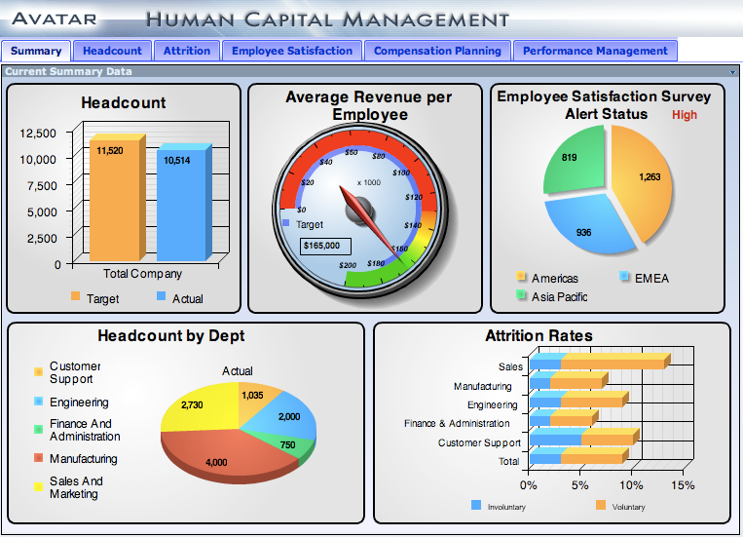
Dashboards
Dashboards are visual display mechanisms used in an operationally oriented performance measurement system
Measures performance against targets and thresholds using right-time data.

Slide 41
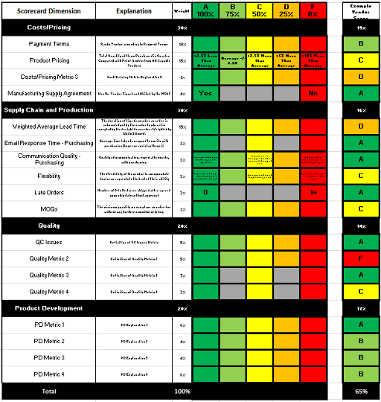
Scorecards
Scorecards are visual displays used in a strategically oriented performance measurement system that chart progress towards achieving strategic goals and objectives
Compares performance against targets and thresholds

Slide 42
Market Migration and Operations
Markets migrate over time
Supply chains must be able to adjust their operations over time
Adaptability is critical to survival
Companies need to know when to shift emphasis in various areas

Slide 43
Sharing Data Across the Supply Chain
Hau Lee, Stanford Business professor, “envisions the supply chain as an intricate network of suppliers, distributors and customers who share carefully managed information about demand, decisions and performance and who recognize that success for one part of the supply chain means success for all.”

Slide 44
Sharing Data Across the Supply Chain
Companies that can work together to create efficient supply chains are going to do best over time.
Companies that share data effectively will create the most competitive supply chains
More efficient supply chains lead to a competitive advantage

Slide 45
Metrics, Benchmarking & Best Practices

Slide 46
References
https://www.werc.org/assets/1/Events/Metrics_Benchmarking_10_2014_NTEXAS.pdf
https://www.werc.org/assets/1/workflow_staging/AssetManager/3761.PDF

Slide 47
IMSE 802 Supply Chain Operations and Decision Making
Lecture 6
Chapter 5
Metrics for Measuring Supply Chain Performance

